Slide 1

COVID-19 Clinical Trials Analysis
Submitted by –Rishav Kumar Sharma

Slide 2
Key Findings
Most trials are either Completed or Recruiting.
Targeted mainly at adult populations of all genders.
Phase 2 and Phase 3 trials dominate.
The United States and France lead in contributions.
Spike in trial registrations around mid-2020.
Preprocessing involved imputation and dropping columns with high missing values.
Median used for skewed fields like Enrollment.

Slide 3

📊 Trial Status Distribution
Completed: 3,500 trials
Recruiting: 2,900 trials
Not Yet Recruiting: 600 trials
Withdrawn: 150 trials

Slide 4
🧪 Phase Distribution
Phase 1: 800
Phase 2: 2,200
Phase 3: 2,400
Phase 4: 600
Not Applicable: 950

Slide 5
🌍 Top Contributing Countries
United States: 3,800 trials
France: 1,600
India: 1,100
Brazil: 950
China: 900

Slide 6
📈 Enrollment Statistics
Median: 120
Mean: 340
Max: 20,000
Min: 1

Slide 7
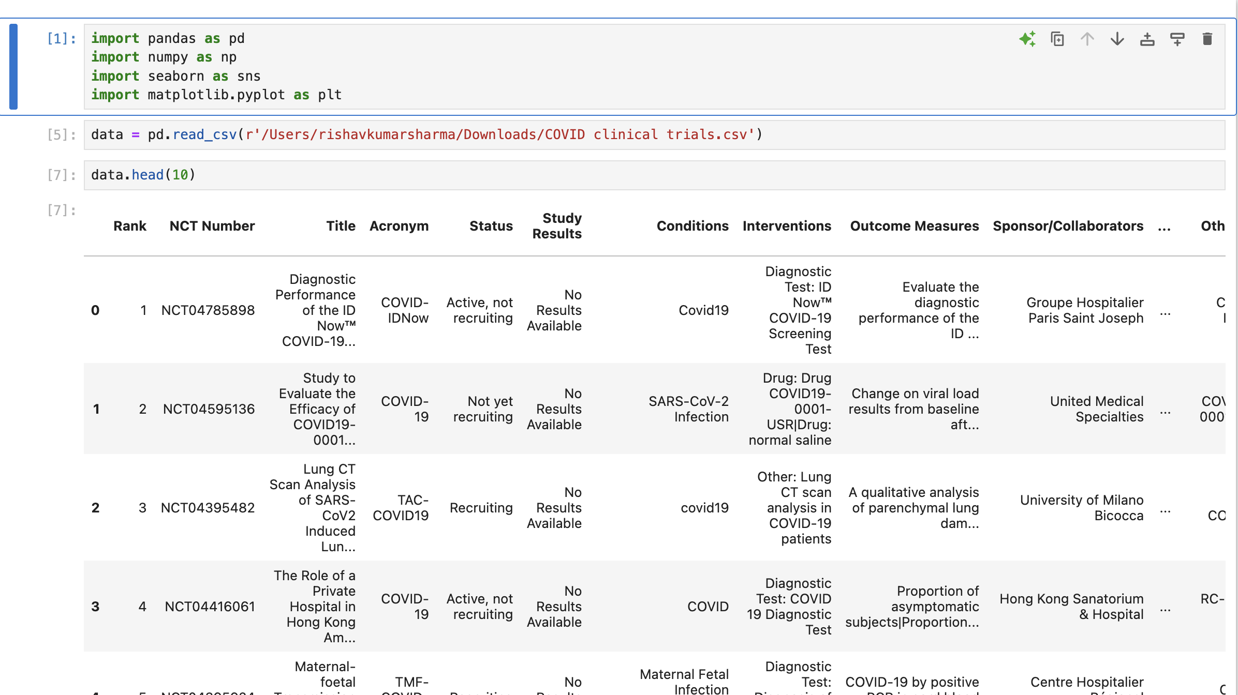
Data Exploration

Slide 8
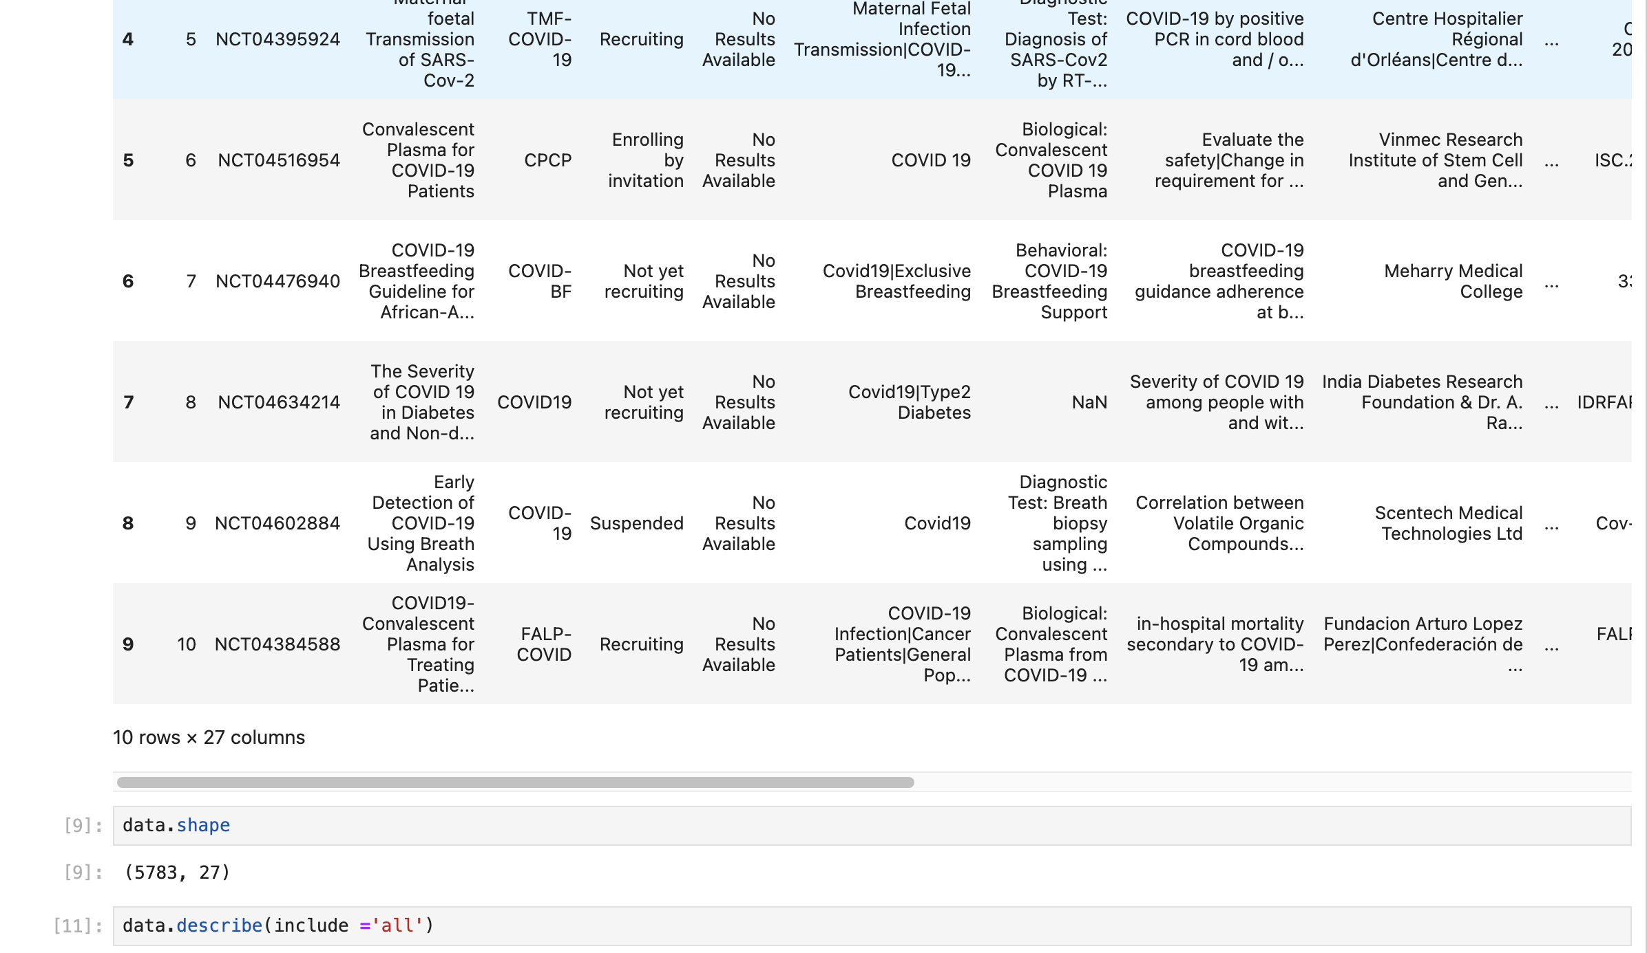

Slide 9
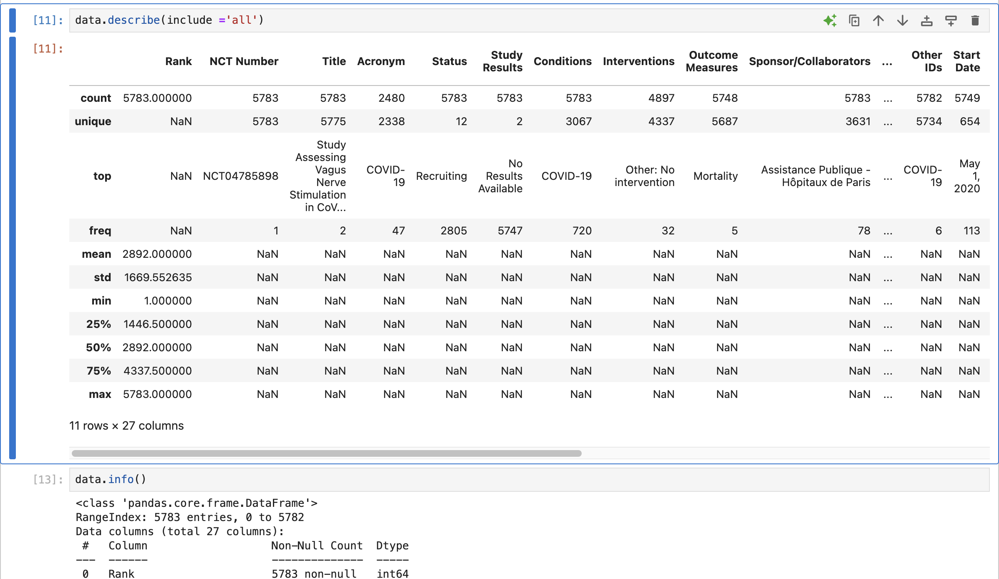

Slide 10
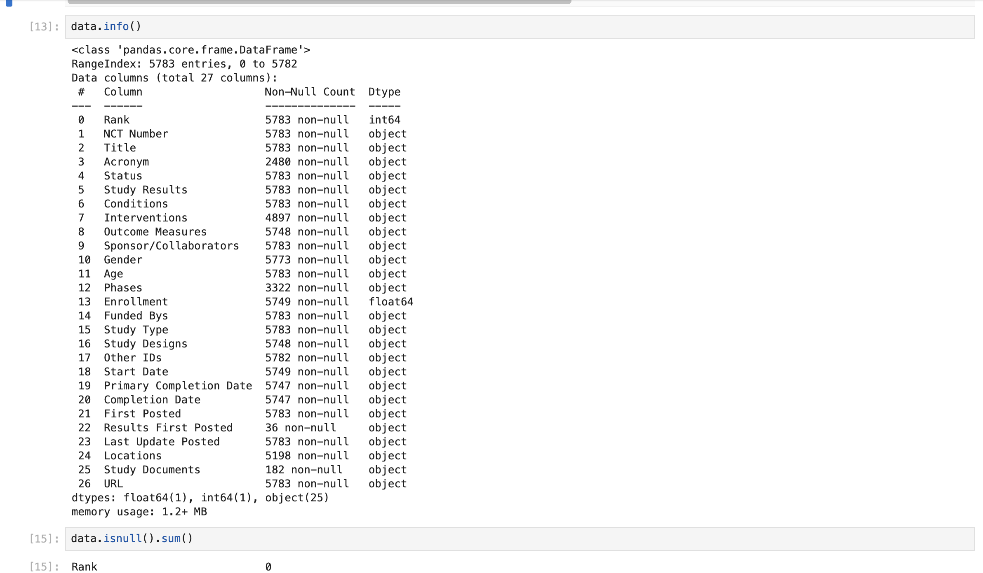

Slide 11
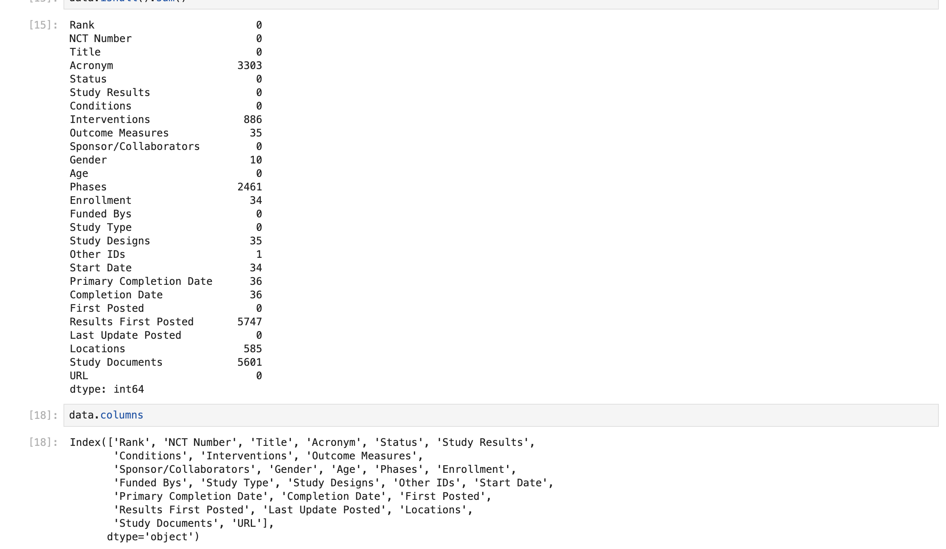

Slide 12
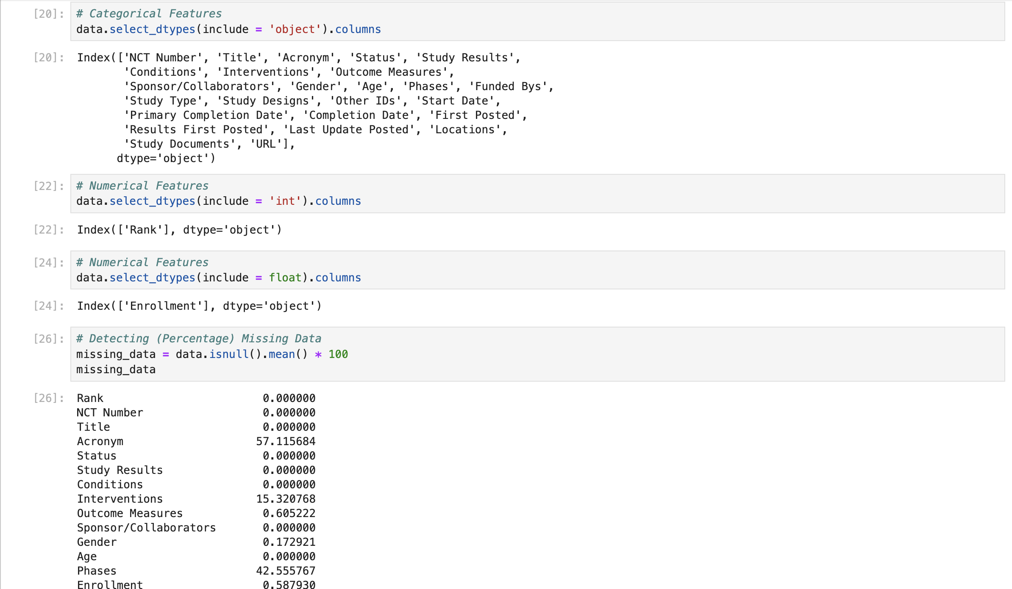
Detecting Missing Data (Data Cleaning)

Slide 13
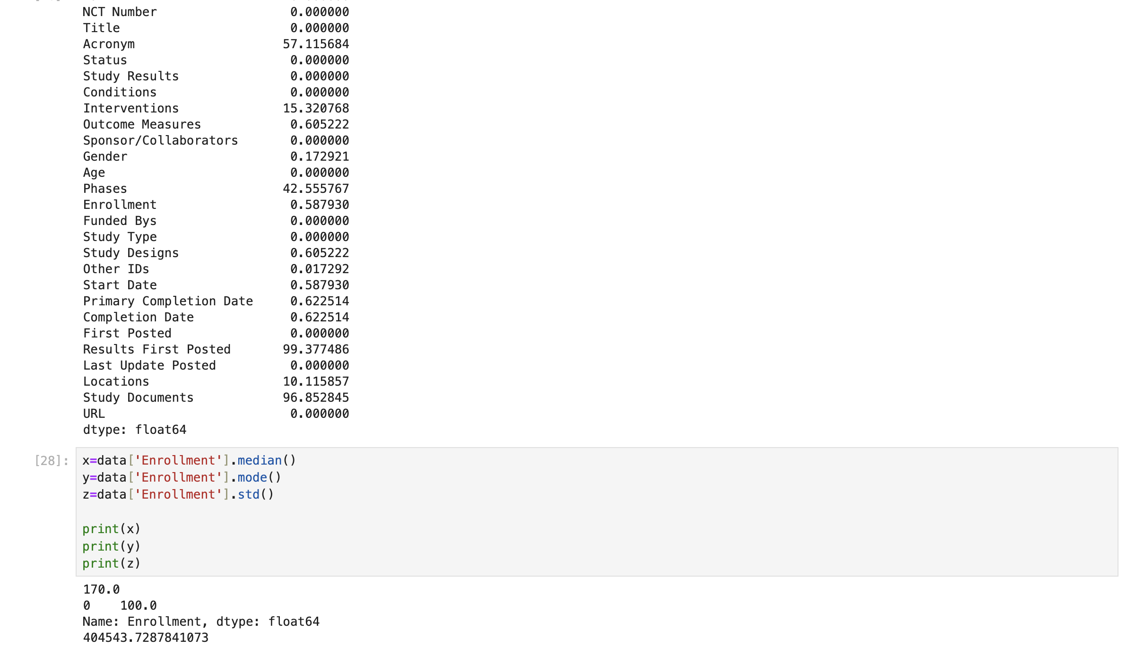

Slide 14
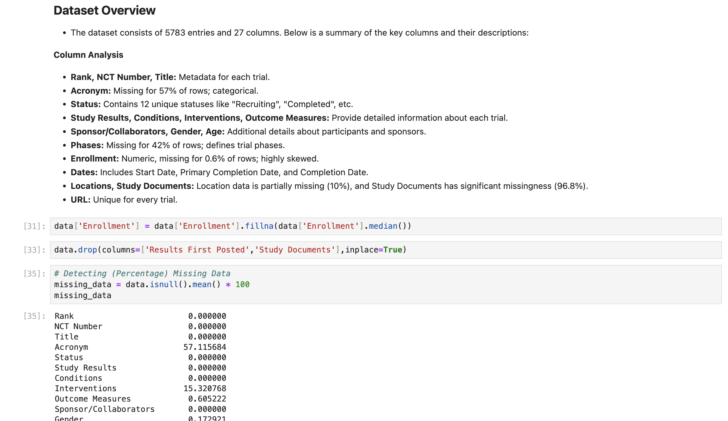
Dataset Overview

Slide 15
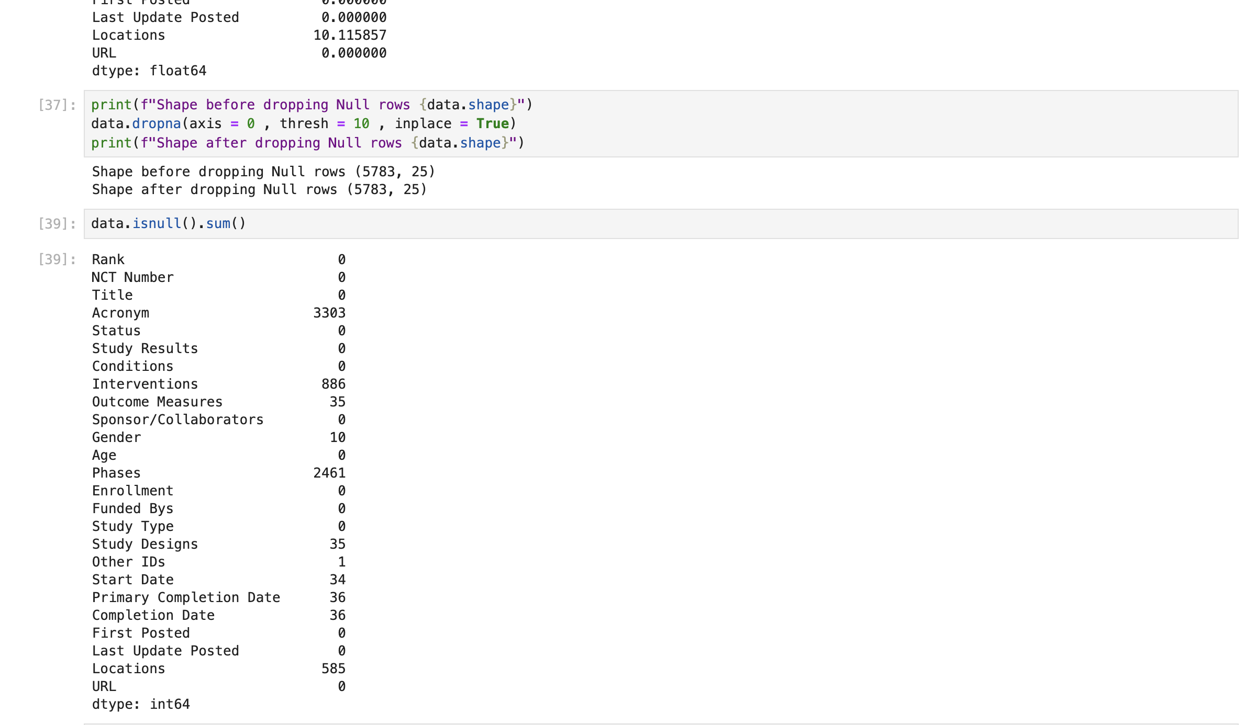

Slide 16
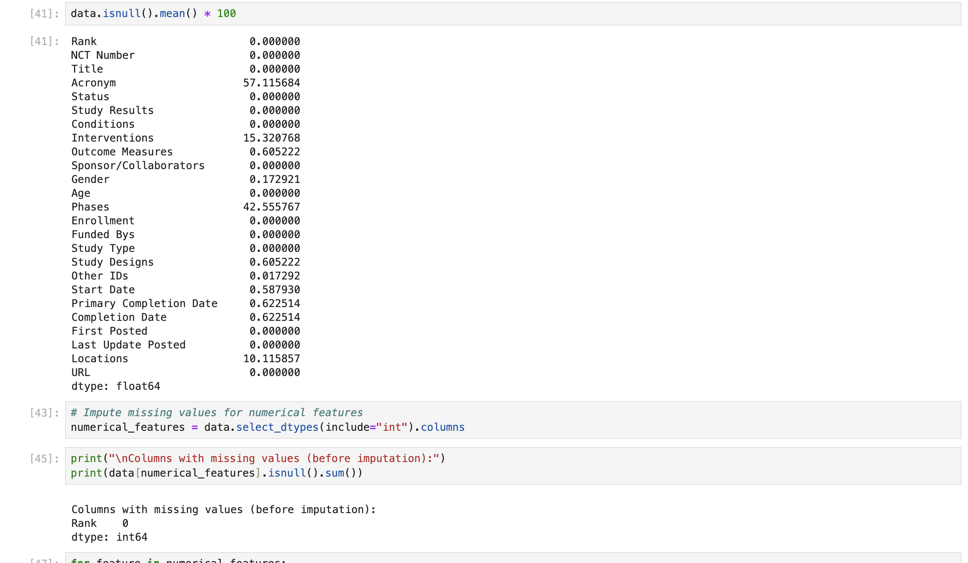
Data Analysis

Slide 17
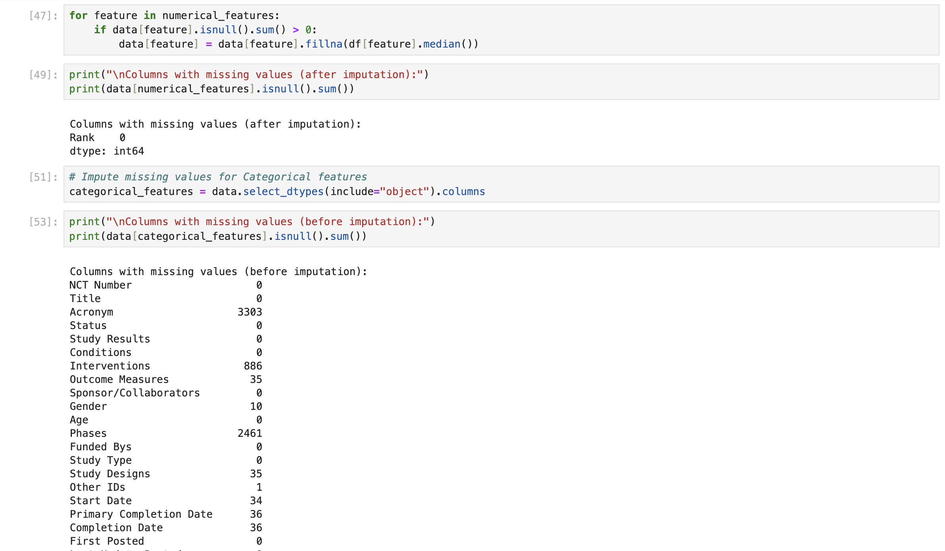

Slide 18
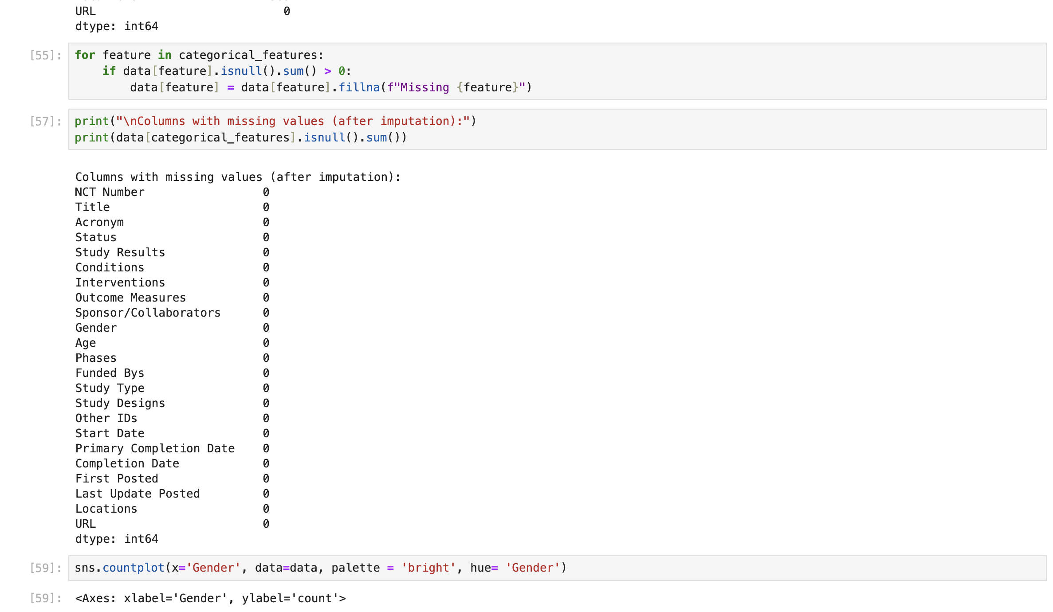

Slide 19
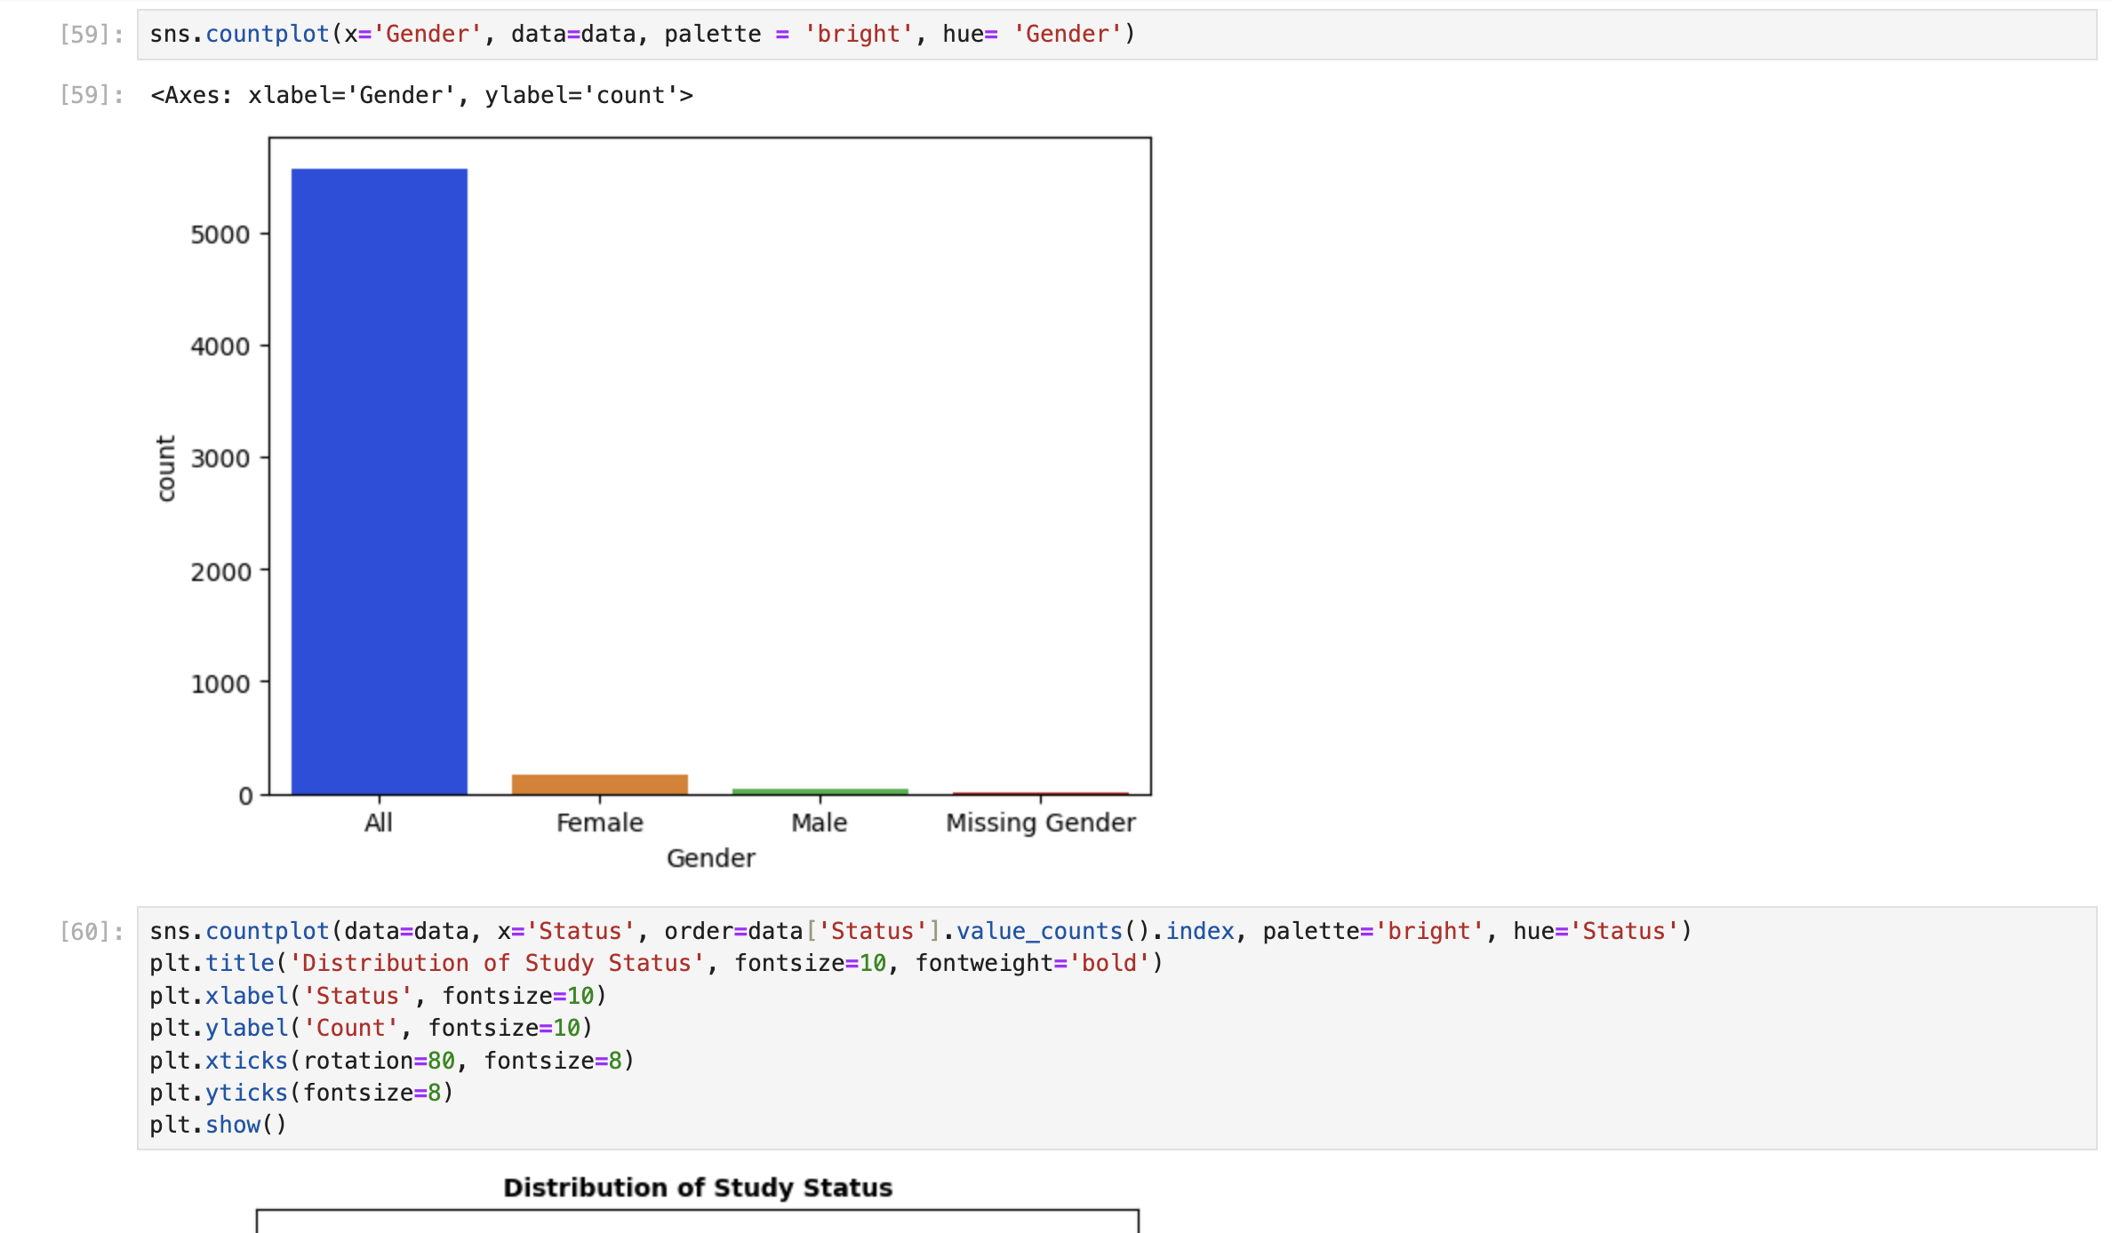
Genders
Data Visualization

Slide 20
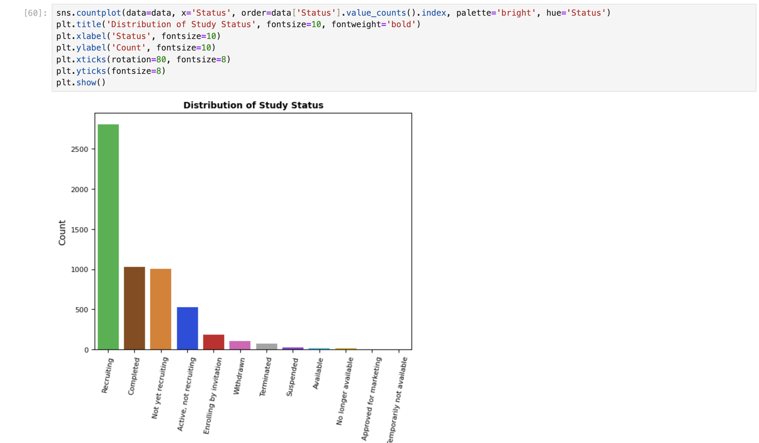
Distribution of Study Status

Slide 21
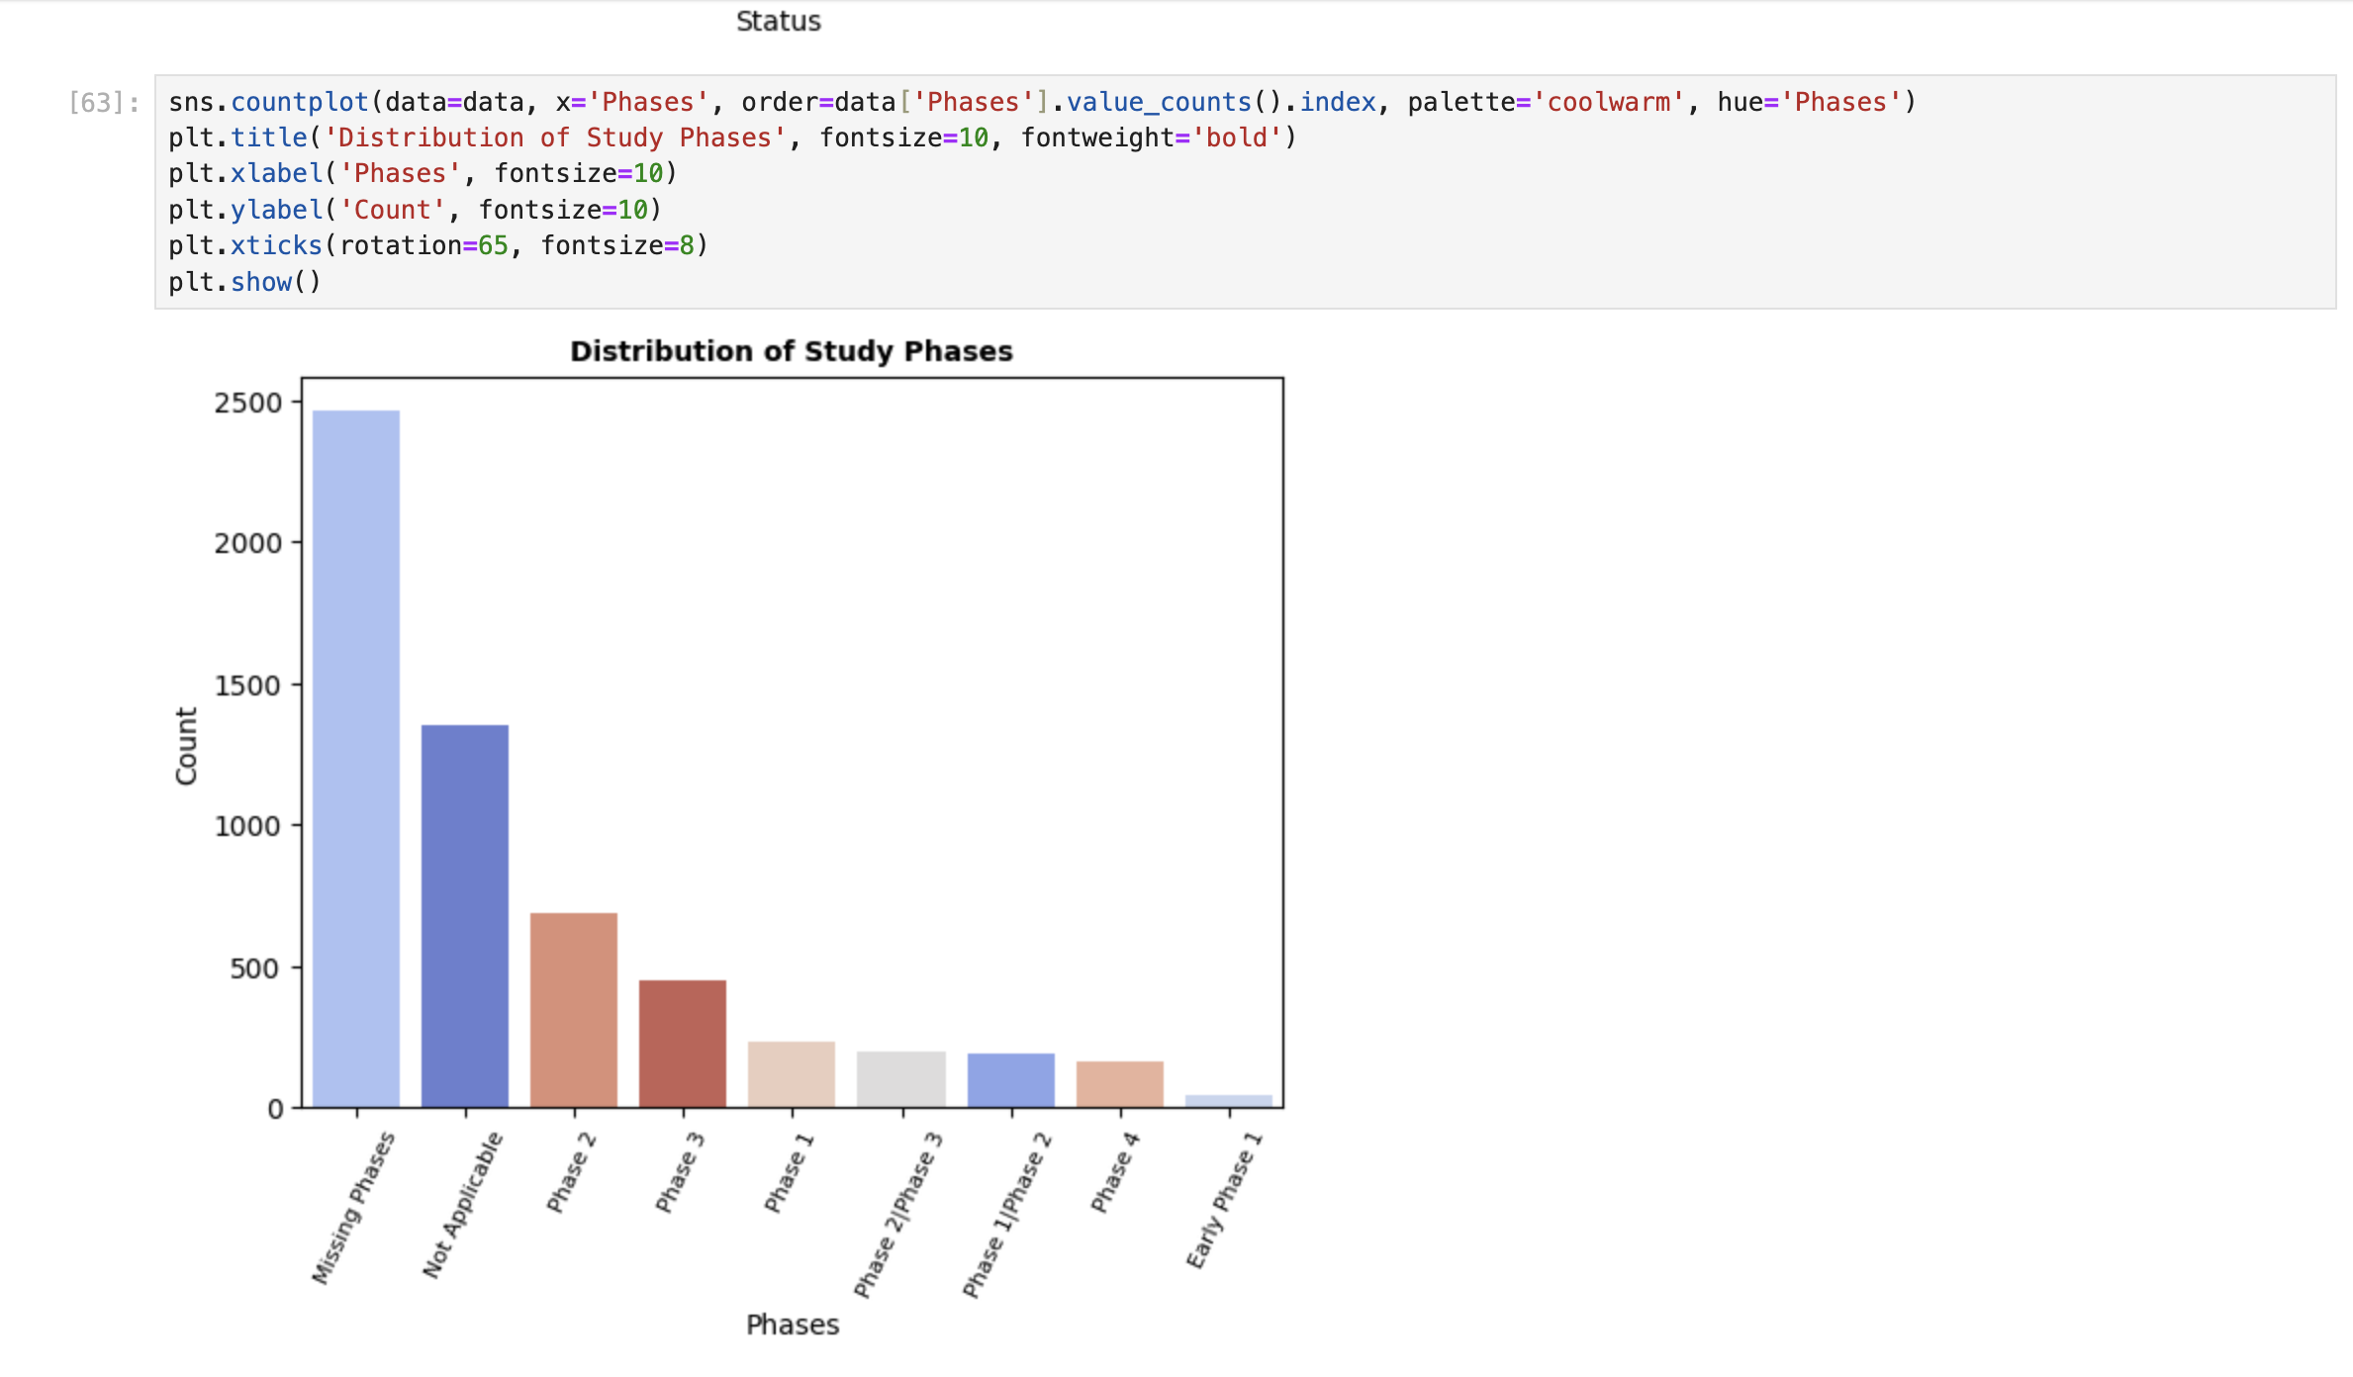
Distribution of study Phases

Slide 22
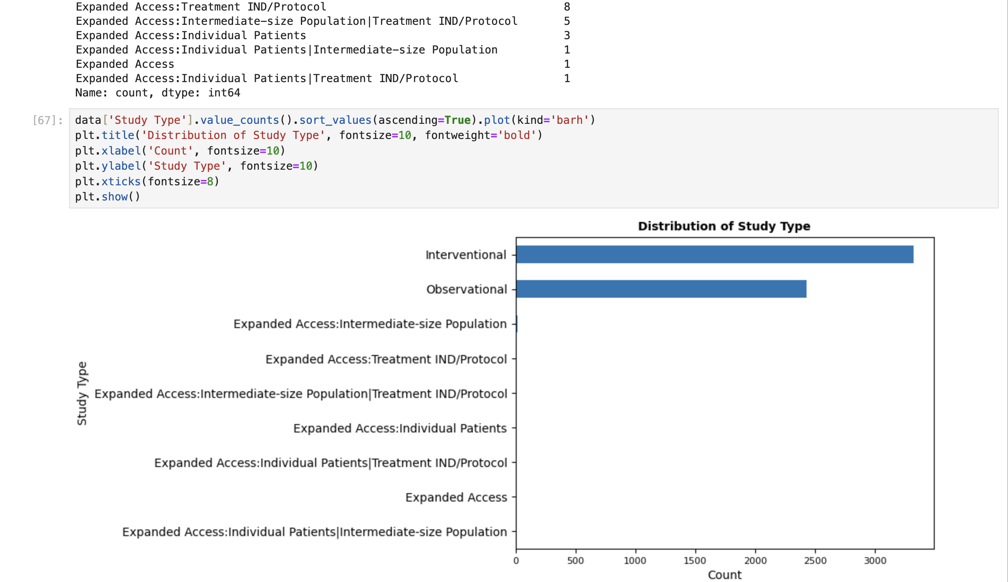
Distribution of Study Type

Slide 23
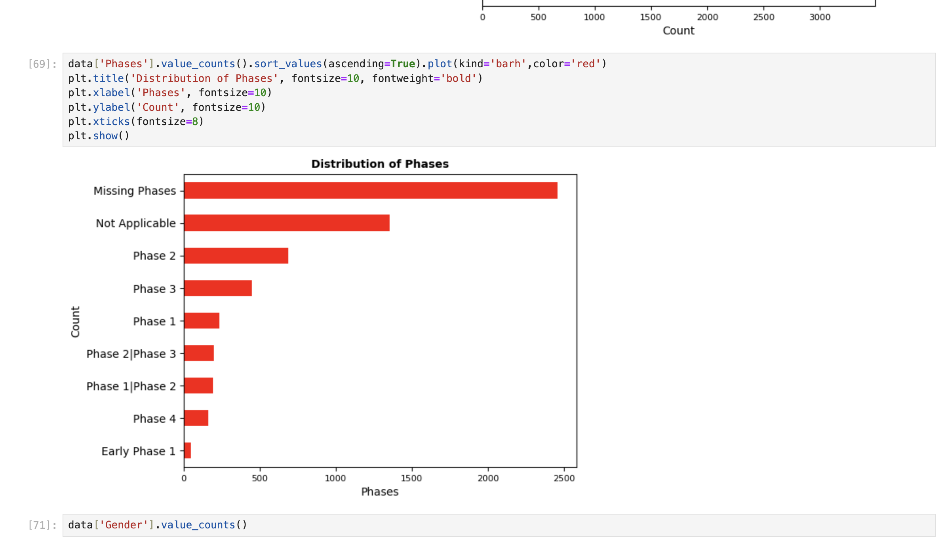
Distribution of Phases

Slide 24
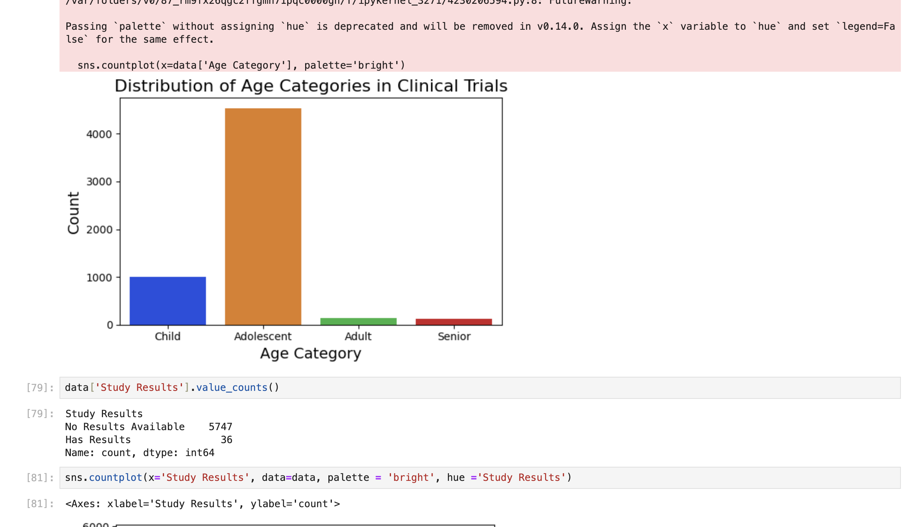
Distribution of Age Categories in Clinincal Trails

Slide 25
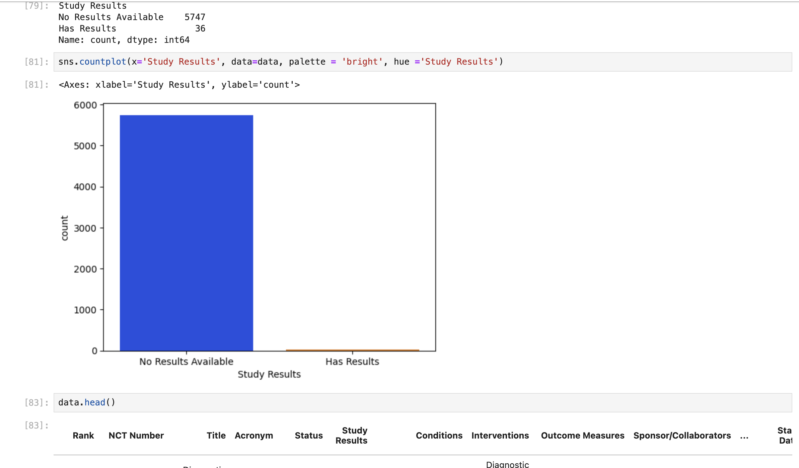
Study Results

Slide 26
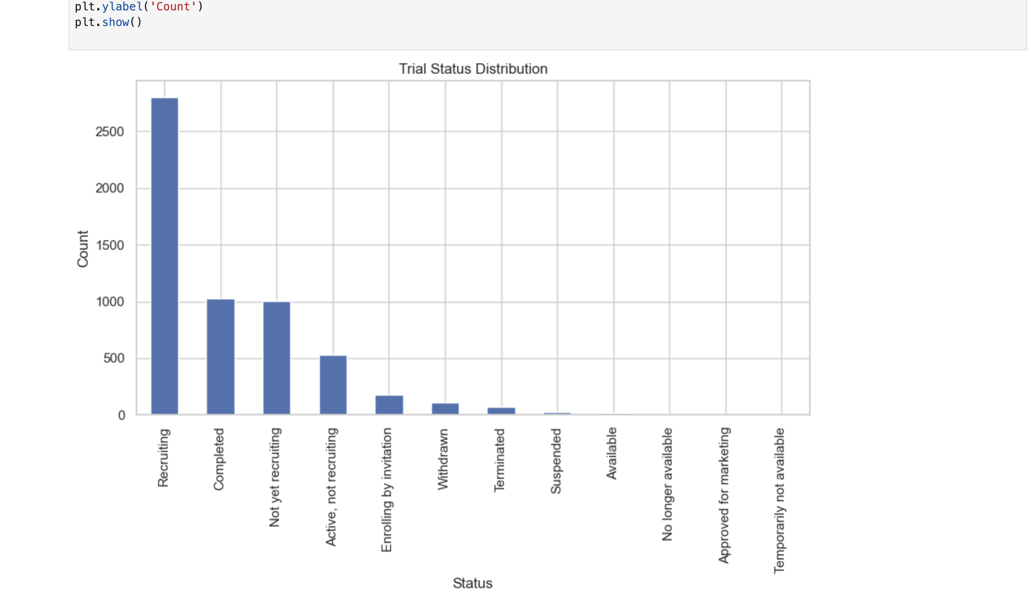
Trial Status Distribution

Slide 27
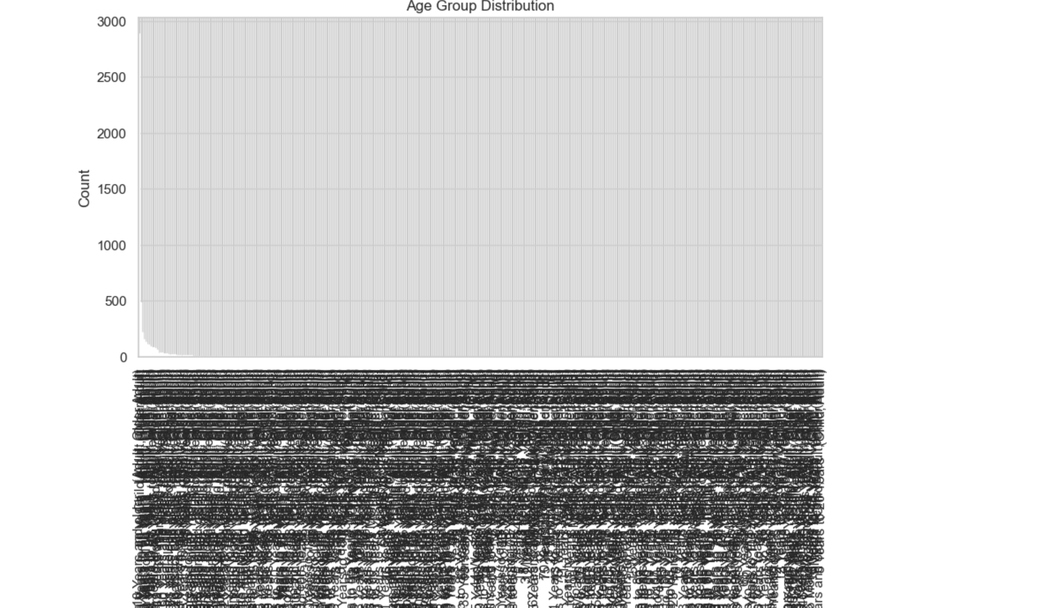
Age Group Distribution

Slide 28
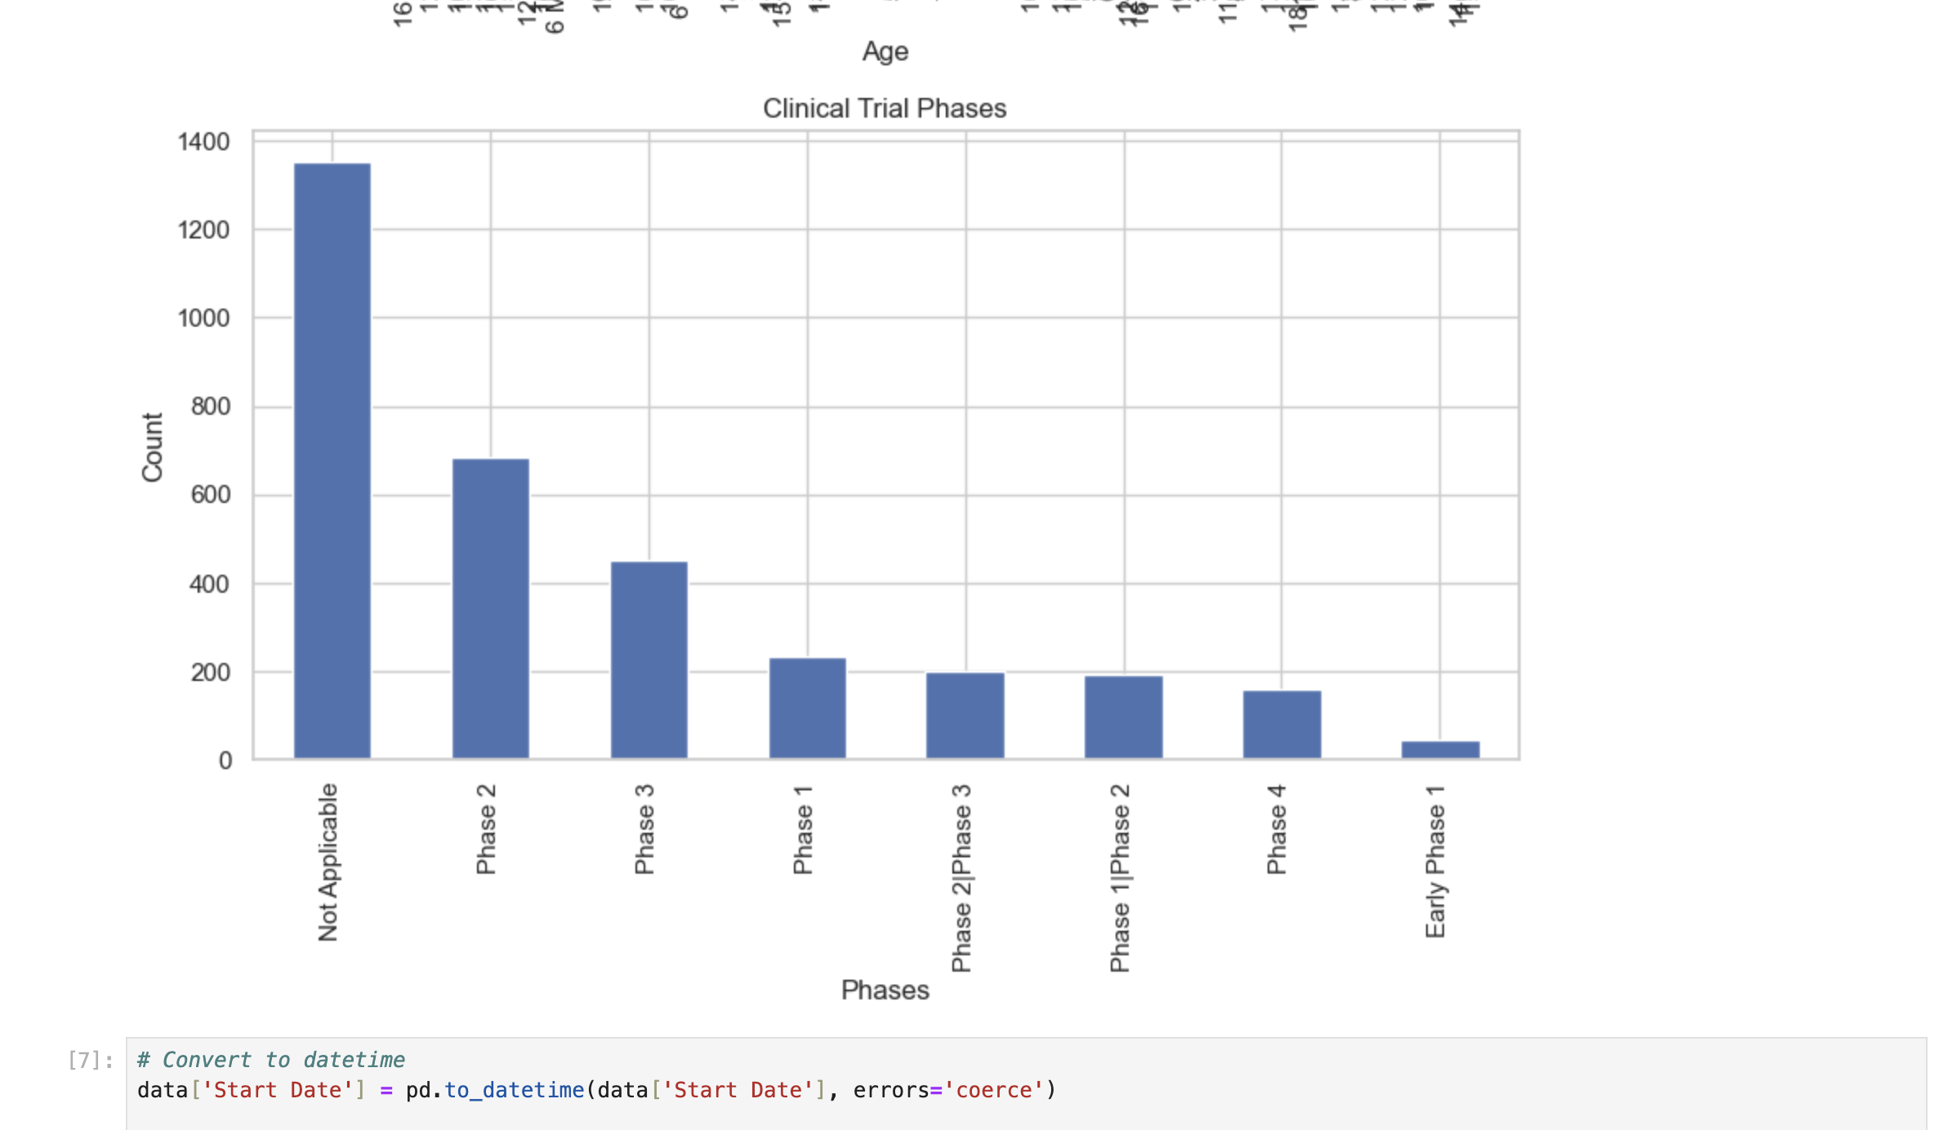
Phases

Slide 29
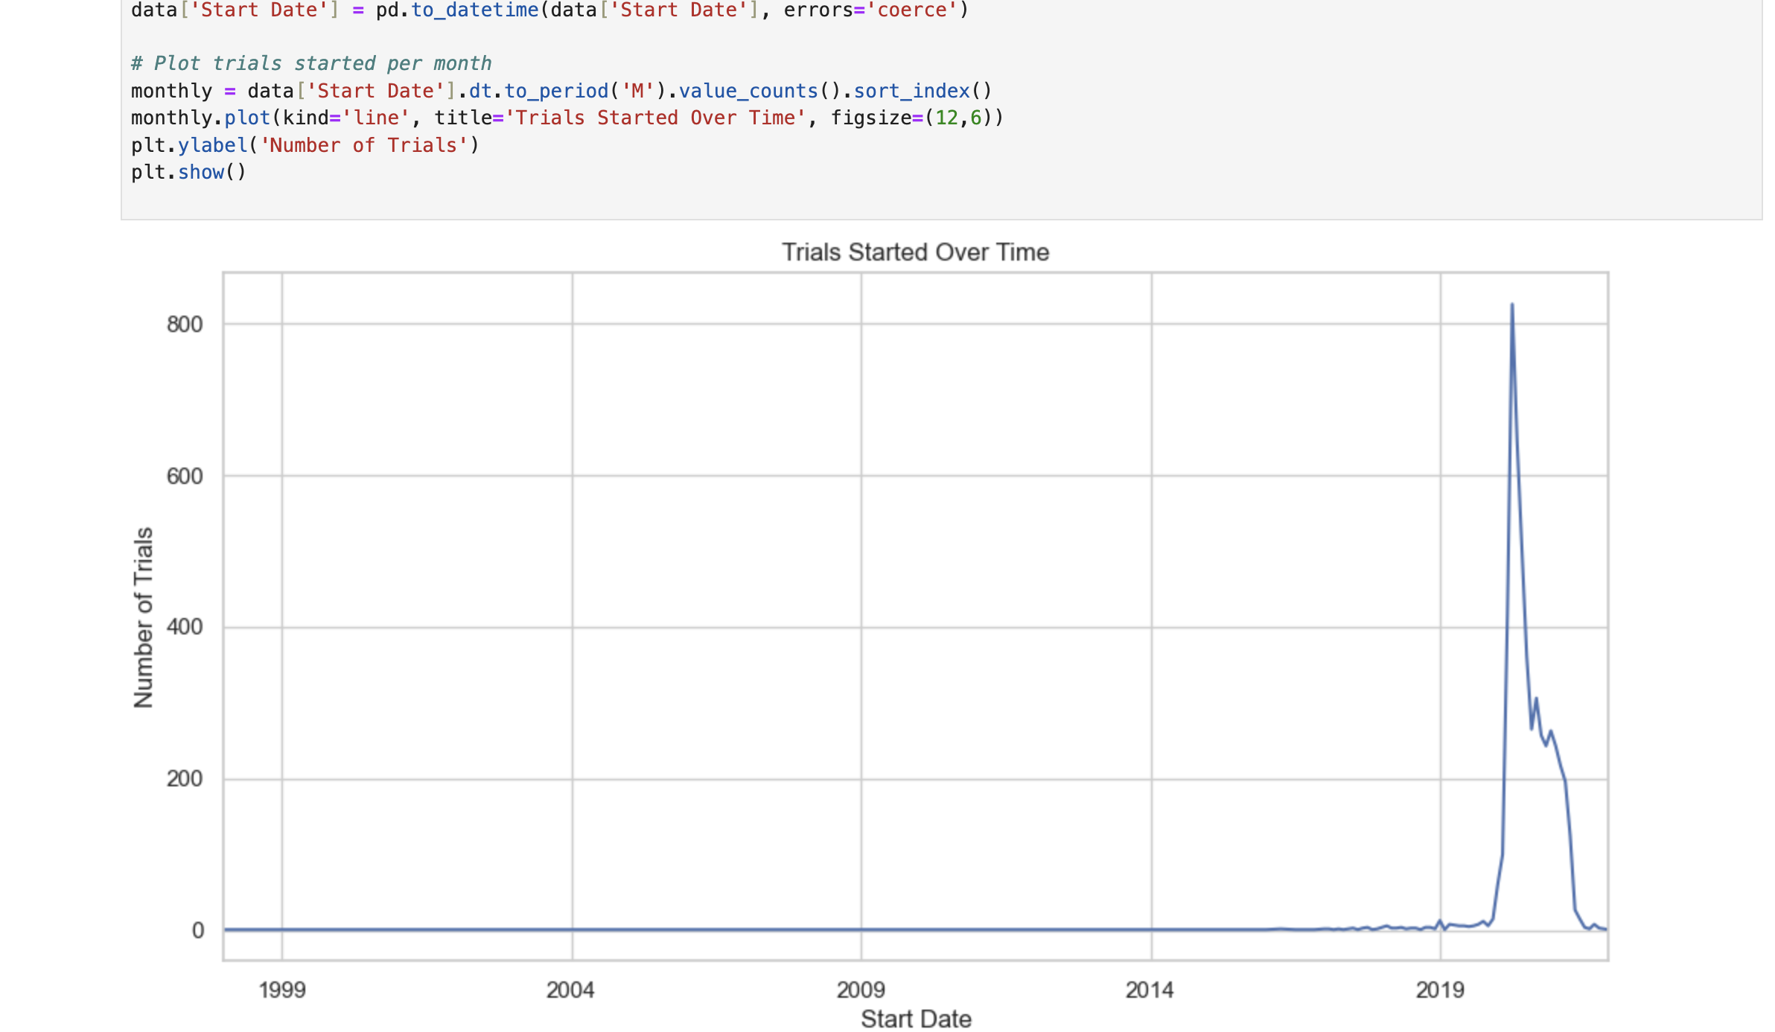
Trails Started over time

Slide 30
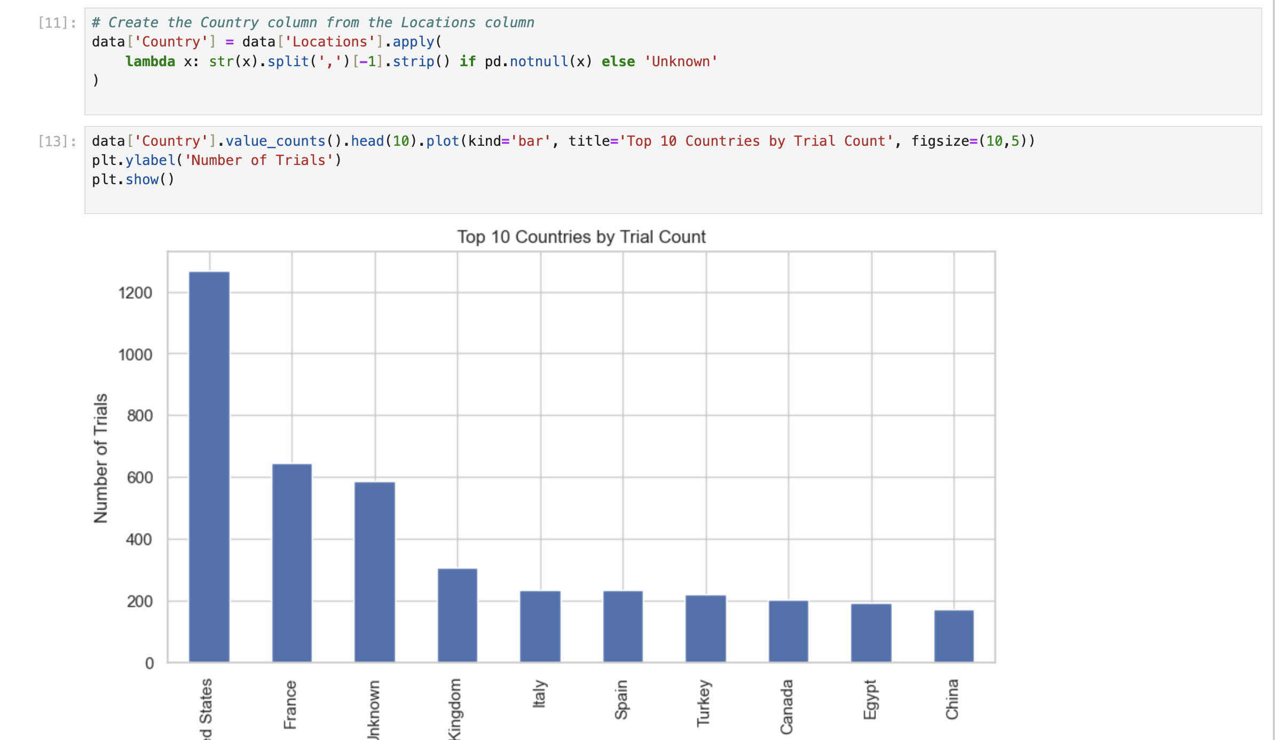
Top 10 Countries by Trial Count

Slide 31
